Slide 1
Deep Learning for Biology
Joris Roels

Slide 2
Recurrent Neural Networks

Slide 3

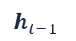




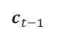
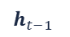


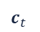
Overview
${\hat{y}}_{t}$
$h_{t−1}$
$h_{t}$
Introduction
Sequence modelling
Recurrent Neural Networks
Vanishing gradients
Long Short Term Memory Networks
Variants of RNNs
tanh
$x_{t}$
${\hat{y}}_{t}$
$c_{t−1}$
$c_{t}$
tanh
$h_{t−1}$
$σ$
$σ$
tanh
$σ$
$h_{t}$
$x_{t}$

Slide 4
Introduction

Slide 5
Introduction
Example: predict the future location of a ball
➔ Without prior knowledge
??

Slide 6
Introduction
Example: predict the future location of a ball
➔ With prior knowledge

Slide 7



Introduction
So far, we have only seen predictive models for fixed input data dimensions: feed-forward models
Convolutional neural networks
Multi-layer perceptrons

Slide 8
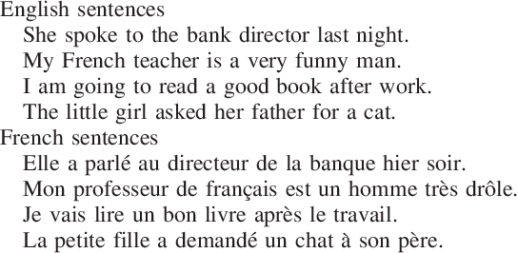
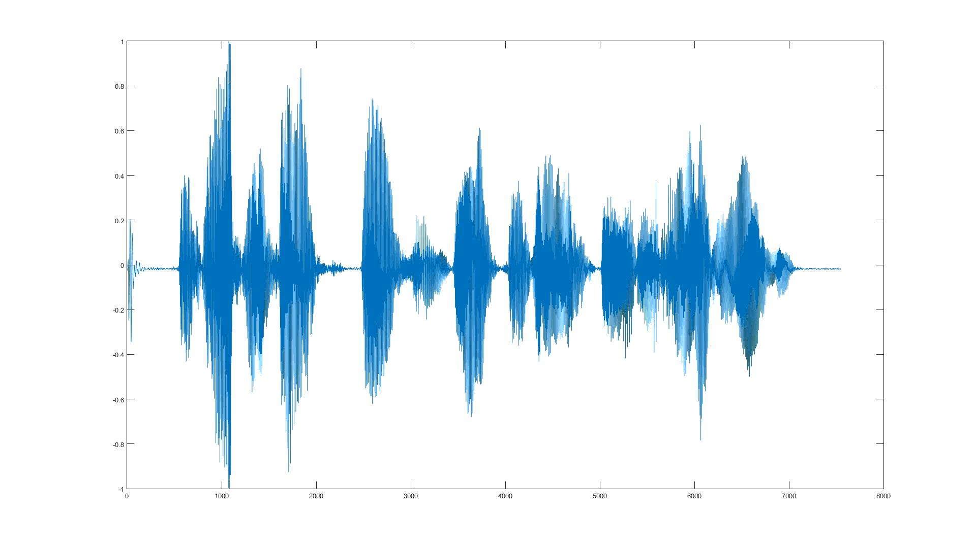
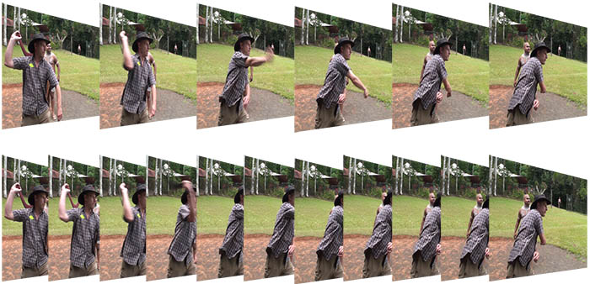

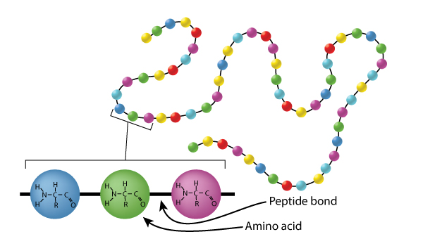
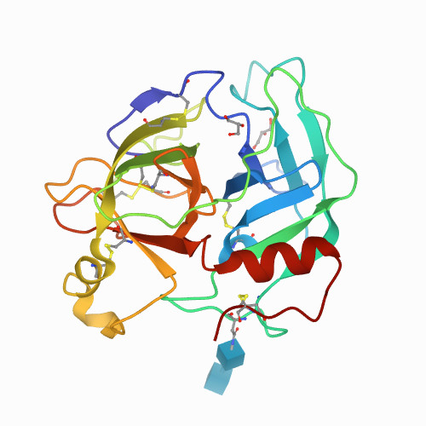
Introduction
What about sequences of data?
Text
Speech
Video
Financial stock
In biology: sequencing
…

Slide 9
Sequence modelling

Slide 10











Sequence modelling
$x_{1}$
$h_{1}$
$y_{1}$
$x_{2}$
$h_{2}$
$y_{2}$
$$…$$
$$…$$
$$…$$
$x_{n}$
$h_{m}$
$y_{l}$
Example: predicting the next word
This morning I took my dog for a walk
Classical MLP: specify the size of the input
Given these words
Predict the next word

Slide 11






Sequence modelling
Idea: use a fixed window
This morning I took my dog for a walk
How to encode this numerically?
Split the input vector in parts
Given these words
Predict the next word
$0$
$1$
$0$
$1$
for
a
$0$
$1$
prediction

Slide 12
Sequence modelling
Problem: can’t model long-term dependencies
France is where I grew up, but now I live in Boston. I speak fluent …
➔ Information from the distant past is required to accurately predict the next word

Slide 13









Sequence modelling
Idea: use entire sequence as sets of counts
This morning I took my dog for a walk
How to encode this numerically?
Fixed length vector with word counts
Bag of words
Given these words
Predict the next word
$1$
$0$
$1$
$0$
$1$
$0$
$0$
$1$
$1$
prediction

Slide 14
Sequence modelling
Problem: counts don’t preserve order
The food was good, not bad at all
The food was bad, not good at all
Same bag of words encoding
Very different meaning

Slide 15















Sequence modelling
Idea: use a really big fixed window
This morning I took my dog for a walk
Given these words
Predict the next word
$1$
$0$
$1$
$0$
$1$
$0$
$1$
$0$
$1$
$0$
$1$
$0$
$1$
$0$
$1$
…
this
morning
I
took
dog
prediction

Slide 16
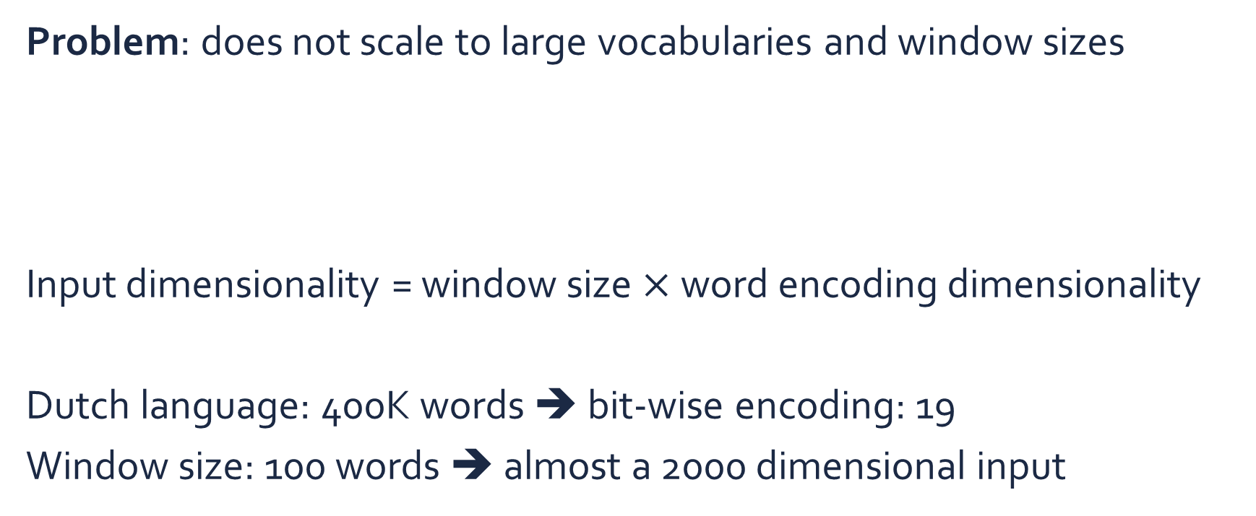















Sequence modelling
Problem: does not scale to large vocabularies and window sizes
Input dimensionality = window size $×$ word encoding dimensionality
Dutch language: 400K words ➔ bit-wise encoding: 19
Window size: 100 words ➔ almost a 2000 dimensional input
$1$
$0$
$1$
$0$
$1$
$0$
$1$
$0$
$1$
$0$
$1$
$0$
$1$
$0$
$1$
…
this
morning
I
took
dog

Slide 17















Sequence modelling
Problem: no parameter sharing
$1$
$0$
$1$
$0$
$1$
$0$
$1$
$0$
$1$
$0$
$1$
$0$
$1$
$0$
$1$
…
this
morning
I
took
dog
Each of these inputs has separate parameter connections to the next (hidden) layer
$1$
$0$
$1$
$0$
$1$
$0$
$1$
$0$
$1$
$1$
$0$
$1$
$0$
$1$
$0$
…
I
took
dog
this
morning
➔ Things we learn about the sequence won’t transfer if they appear elsewhere in the sequence

Slide 18
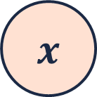

Sequence modelling
$\hat{y}$
To model sequences, we need to
Handle variable-length sequences
Track long-term dependencies
Maintain information about ordering
Share parameters across the sequence
➔ Recurrent Neural Networks (RNNs) are a suitable approach for sequence modelling problems
RNN
$x$

Slide 19
Recurrent Neural Networks

Slide 20


Recurrent neural networks
$\hat{y}$
… many other architectures!
$x$
One to one
“Standard” neural network
Many to one
e.g. sentiment classification
Many to many
e.g. text translation

Slide 21

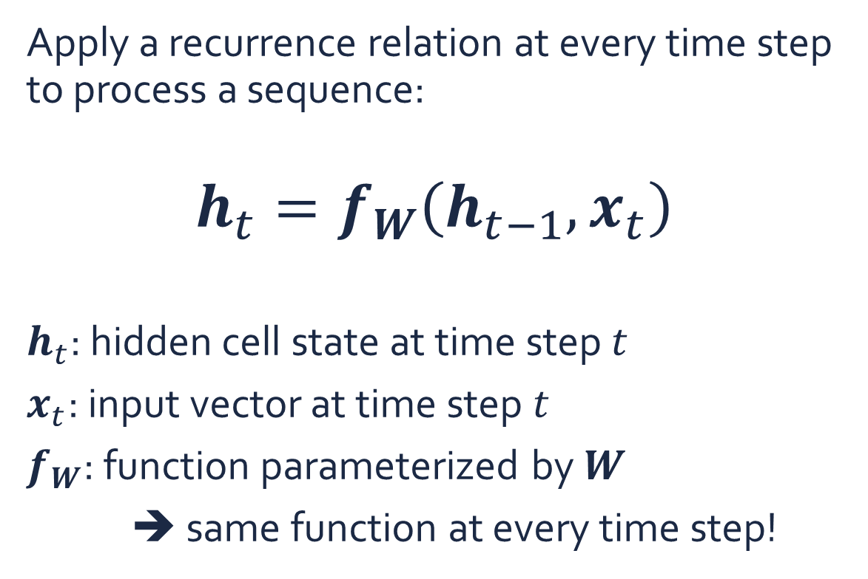

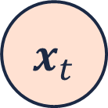
Recurrent neural networks
${\hat{y}}_{t}$
Apply a recurrence relation at every time step to process a sequence:
$$h_{t}=f_{W}\left(h_{t−1},x_{t}\right)$$
$h_{t}$: hidden cell state at time step $t$
$x_{t}$: input vector at time step $t$
$f_{W}$: function parameterized by $W$
➔ same function at every time step!
RNN
$$h_{t}$$
Recurrent cell
$x_{t}$

Slide 22
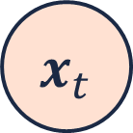


Recurrent neural networks
rnn = RNN()
h = [0,0,0,0]
sentence = [“this”, “morning”, “I”, “took”, “my”, “dog”, “for”, “a”]
for each word in sentence:
prediction, h = rnn(word, h)
next_word = prediction
# >>> “walk”
${\hat{y}}_{t}$
output vector
RNN
$$h_{t}$$
hidden cell state
Recurrent cell
$x_{t}$
input vector

Slide 23


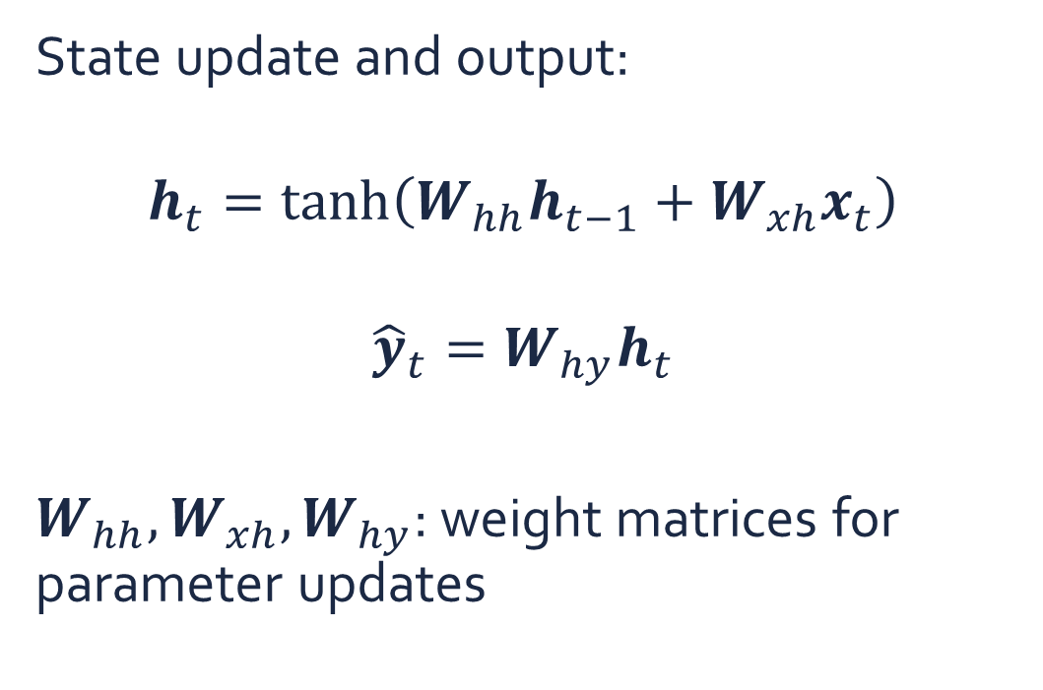

Recurrent neural networks
State update and output:
$$h_{t}=\tanh\left(W_{hh}h_{t−1}+W_{xh}x_{t}\right)$$
$${\hat{y}}_{t}=W_{hy}h_{t}$$
$W_{hh},W_{xh},W_{hy}$: weight matrices for parameter updates
${\hat{y}}_{t}$
output vector
$$W_{hy}$$
$$W_{hh}$$
RNN
hidden cell state
$$h_{t}$$
Recurrent cell
$$W_{xh}$$
$x_{t}$
input vector

Slide 24

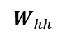






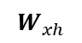



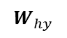

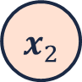


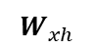

Recurrent neural networks
$L$
Graph unfolding & forward propagation
$L_{0}$
$L_{1}$
$L_{2}$
…
$L_{t}$
morning
I
took
walk
${\hat{y}}_{t}$
${\hat{y}}_{0}$
${\hat{y}}_{1}$
${\hat{y}}_{2}$
…
${\hat{y}}_{t}$
$$W_{hy}$$
$$W_{hy}$$
$$W_{hy}$$
$$W_{hy}$$
RNN
$$W_{hh}$$
$$W_{hh}$$
$$W_{hh}$$
$$W_{hh}$$
…
$$W_{xh}$$
$$W_{xh}$$
$$W_{xh}$$
$$W_{xh}$$
$x_{t}$
$x_{0}$
$x_{1}$
$x_{2}$
…
$x_{t}$
this
morning
I
a

Slide 25
Recurrent neural networks
Forward pass
Backward pass
$L$
Backpropagation through time
$L_{0}$
$L_{1}$
$L_{2}$
…
$L_{t}$
${\hat{y}}_{t}$
${\hat{y}}_{0}$
${\hat{y}}_{1}$
${\hat{y}}_{2}$
…
${\hat{y}}_{t}$
$$W_{hy}$$
$$W_{hy}$$
$$W_{hy}$$
$$W_{hy}$$
RNN
$$W_{hh}$$
$$W_{hh}$$
$$W_{hh}$$
$$W_{hh}$$
…
$$W_{xh}$$
$$W_{xh}$$
$$W_{xh}$$
$$W_{xh}$$
$x_{t}$
$x_{0}$
$x_{1}$
$x_{2}$
…
$x_{t}$

Slide 26
Vanishing gradients

Slide 27
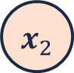


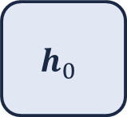
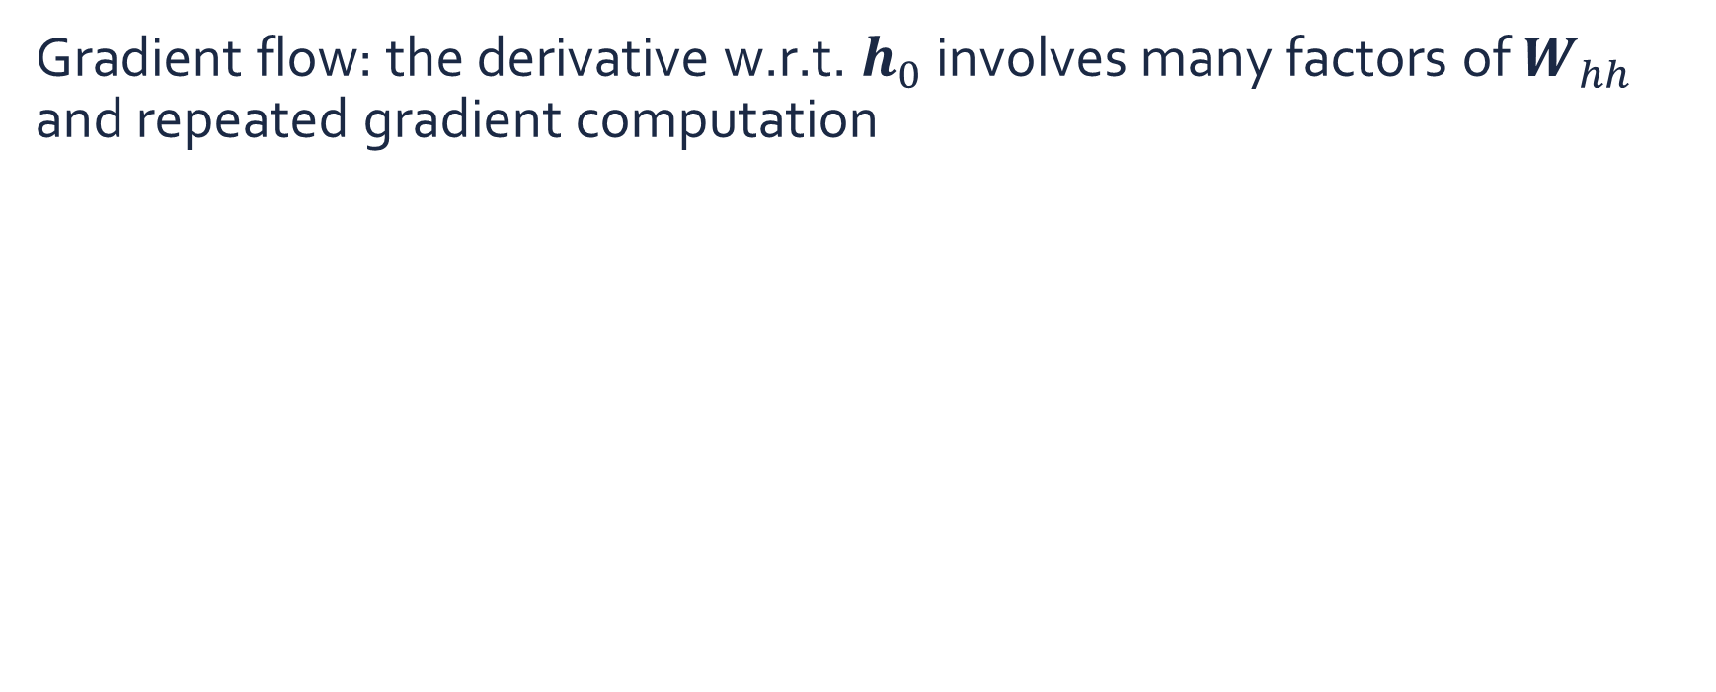

Vanishing gradients
Forward pass
Backward pass
Gradient flow: the derivative w.r.t. $h_{0}$ involves many factors of $W_{hh}$ and repeated gradient computation
$$h_{0}$$
$$W_{hh}$$
$$W_{hh}$$
$$W_{hh}$$
$$W_{hh}$$
…
$$W_{xh}$$
$$W_{xh}$$
$$W_{xh}$$
$$W_{xh}$$
$x_{0}$
$x_{1}$
$x_{2}$
…
$x_{t}$
Many values > 1:
Exploding gradients
Gradient clipping: scale gradients
Many values < 1:
Vanishing gradients
Activation function
Weight initialization
Network architecture

Slide 28

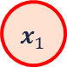

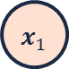
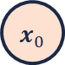


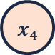

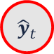
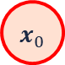
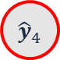
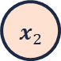
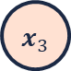
Vanishing gradients
The clouds are in the …
Why are vanishing gradients a problem?
Multiply many small numbers together
Errors due to time steps further back have smaller and smaller gradients
Parameters are biased to capture short-term dependencies
${\hat{y}}_{0}$
${\hat{y}}_{1}$
${\hat{y}}_{2}$
${\hat{y}}_{3}$
${\hat{y}}_{4}$
$x_{0}$
$x_{1}$
$x_{2}$
$x_{3}$
$x_{4}$
France is where I grew up, but now I live in Boston. I speak fluent …
${\hat{y}}_{0}$
${\hat{y}}_{1}$
${\hat{y}}_{2}$
…
${\hat{y}}_{t}$
…
$x_{0}$
$x_{1}$
$x_{2}$
…
$x_{t}$

Slide 29
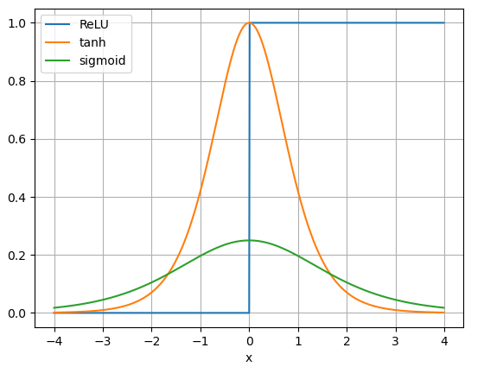
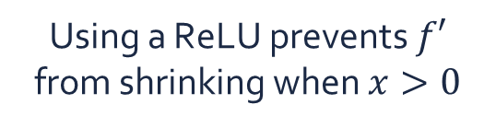
Vanishing gradients
Avoiding vanishing gradients: activation function
Derivatives of activation functions
Using a ReLU prevents $f′$ from shrinking when $x>0$

Slide 30
Vanishing gradients
Avoiding vanishing gradients: parameter initialization
Initialize weights to identity matrix
Initialize biases to zero
Prevents the weights from shrinking to zero

Slide 31
Vanishing gradients
Avoiding vanishing gradients: gated cells
Use a more complex recurrent unit with gates to control what information is passed through
Gated cell
LSTM, GRU, …

Slide 32
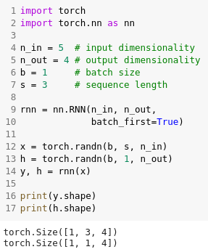


Recurrent neural networks
Neural networks designed for sequence modelling
Recurrent unit
Handles variable-length inputs
Shares parameters across the sequence
Maintains information about ordering
Learning long-term dependencies is challenging due to vanishing gradients
Activation functions
Parameter initialization
Gated cells
Implementation in PyTorch
${\hat{y}}_{t}$
RNN
$x_{t}$

Slide 33
Long Short Term Memory Networks

Slide 34
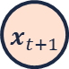
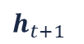


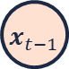
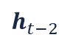

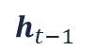


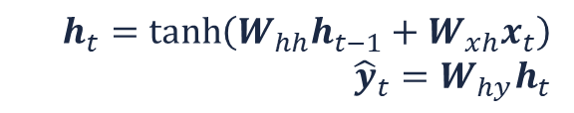
Recurrent neural networks
$$h_{t}=\tanh\left(W_{hh}h_{t−1}+W_{xh}x_{t}\right)$$
$${\hat{y}}_{t}=W_{hy}h_{t}$$
In an RNN, the recurrent cell contains a simple computation node
${\hat{y}}_{t−1}$
${\hat{y}}_{t}$
${\hat{y}}_{t+1}$
$h_{t−2}$
$h_{t−1}$
$h_{t}$
$h_{t+1}$
tanh
tanh
tanh
$x_{t−1}$
$x_{t}$
$x_{t+1}$

Slide 35
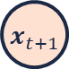







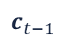
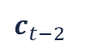


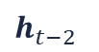


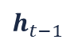
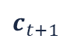

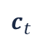

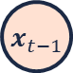
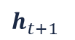
Long short term memory (LSTM)
LSTM modules (Hochreiter et.al., 1997) contain computational blocks that control information flow
${\hat{y}}_{t−1}$
${\hat{y}}_{t}$
${\hat{y}}_{t+1}$
$c_{t−2}$
$c_{t−1}$
$c_{t}$
$c_{t+1}$
tanh
tanh
tanh
$h_{t−2}$
$σ$
$σ$
tanh
$σ$
$h_{t−1}$
$σ$
$σ$
tanh
$σ$
$h_{t}$
$σ$
$σ$
tanh
$σ$
$h_{t+1}$
$x_{t−1}$
$x_{t}$
$x_{t+1}$

Slide 36


Long short term memory
Information is added or removed through structures called gates
Gates allow information to pass, for example, via a sigmoid layer and point-wise multiplication
$σ$

Slide 37
Long short term memory
1) Forget 2) Store 3) Update 4) Output
${\hat{y}}_{t}$
$c_{t−1}$
$c_{t}$
tanh
$h_{t−1}$
$σ$
$σ$
tanh
$σ$
$h_{t}$
$x_{t}$

Slide 38



Long short term memory
1) Forget 2) Store 3) Update 4) Output
LSTMs forget irrelevant parts of the previous input
${\hat{y}}_{t}$
$c_{t−1}$
$c_{t}$
tanh
$σ$
$σ$
tanh
$σ$
$h_{t−1}$
$σ$
$h_{t}$
$h_{t−1}$
$x_{t}$
$x_{t}$

Slide 39



Long short term memory
1) Forget 2) Store 3) Update 4) Output
LSTMs store relevant new information into the cell state
${\hat{y}}_{t}$
$c_{t−1}$
$c_{t}$
tanh
$σ$
$σ$
tanh
$h_{t−1}$
$σ$
tanh
$σ$
$h_{t−1}$
$h_{t}$
$x_{t}$
$x_{t}$

Slide 40


Long short term memory
1) Forget 2) Store 3) Update 4) Output
LSTMs selectively update cell state values
${\hat{y}}_{t}$
$c_{t−1}$
$c_{t−1}$
$c_{t}$
$c_{t}$
tanh
$h_{t−1}$
$σ$
$σ$
tanh
$σ$
$h_{t}$
$x_{t}$

Slide 41

Long short term memory
1) Forget 2) Store 3) Update 4) Output
The output gate controls what information is sent to the next time step
${\hat{y}}_{t}$
$c_{t−1}$
$c_{t}$
tanh
tanh
$σ$
tanh
$σ$
$h_{t−1}$
$σ$
$σ$
$h_{t−1}$
$h_{t}$
$h_{t}$
$x_{t}$
$x_{t}$

Slide 42
Long short term memory
1) Forget 2) Store 3) Update 4) Output
${\hat{y}}_{t}$
$c_{t−1}$
$c_{t}$
tanh
$h_{t−1}$
$σ$
$σ$
tanh
$σ$
$h_{t}$
$x_{t}$

Slide 43













Long short term memory
Gradient flow is uninterrupted ➔ less vanishing gradients!
${\hat{y}}_{t−1}$
${\hat{y}}_{t}$
${\hat{y}}_{t+1}$
$c_{t−2}$
$c_{t−1}$
$c_{t}$
$c_{t+1}$
tanh
tanh
tanh
$h_{t−2}$
$σ$
$σ$
tanh
$σ$
$h_{t−1}$
$σ$
$σ$
tanh
$σ$
$h_{t}$
$σ$
$σ$
tanh
$σ$
$h_{t+1}$
$x_{t−1}$
$x_{t}$
$x_{t+1}$

Slide 44








Long short term memory
${\hat{y}}_{t}$
$c_{t−1}$
$c_{t}$
Maintain a separate cell state from what is outputted
Use gates to control the flow of information
Forget gate gets rid of irrelevant information
Store relevant information from current input
Selectively update the cell state
Output gate returns a filtered version of the cell state
Backpropagation through time with uninterrupted gradient flow
Implementation in PyTorch
tanh
$h_{t−1}$
$σ$
$σ$
tanh
$σ$
$h_{t}$
$x_{t}$

Slide 45
Variants of RNNs

Slide 46








Bi-directional RNNs
Bi-directional RNN
“Vanilla” RNN
In many applications, the ‘time’ dimension is also meaningful in the other direction (e.g. sequencing)
Exploiting this structure can improve an RNN significantly
Bi-directional RNNs (Schuster et.al., 1997) are simply two RNNs working together
The first RNN is a “vanilla” RNN
The second RNN uses reversed inputs
Also possible with LSTMs
Implementation in PyTorch
${\hat{y}}_{t}$
${\hat{y}}_{t}$
RNN
RNN
$h_{t}$
RNN
$h_{t}$
$h_{t}^{′}$
$x_{t}$
Reversion
$x_{t}$

Slide 47








Multi-layer RNNs
Two-layer RNN
“Vanilla” RNN
${\hat{y}}_{t}$
RNNs can consist of multiple layers
This is done by simply stacking the recurrent cells on top of each other
Amount of parameters scales with the amount of layers
Increases the capacity of the RNN
Also possible with LSTMs
Implementation in PyTorch
${\hat{y}}_{t}$
RNN
RNN
$h_{t}^{\left(2\right)}$
$h_{t}$
RNN
$h_{t}^{\left(1\right)}$
$x_{t}$
$x_{t}$

Slide 48







Gated recurrent unit (GRU)
${\hat{y}}_{t}$
GRUs (Cho et.al., 2014) are a gating alternative to LSTMs
Also have a forget gate
No output gate
Fewer parameters than LSTM
Has shown to outperform LSTMs on some datasets, but not consistently
Implementation in PyTorch
$h_{t−1}$
$h_{t}$
1-
$σ$
$σ$
tanh
$x_{t}$

Slide 49

RNN applications in biology
Protein secondary structure prediction (AlphaFold, Google DeepMind)

Slide 50

RNN applications in biology
Transcription factor binding sites prediction (Shen et.al., 2018)

Slide 51
Summary
${\hat{y}}_{t}$
$h_{t−1}$
$h_{t}$
Sequence modelling inefficient with MLPs and requires a completely different architecture
Variable length
Long-term dependencies
Maintain ordering
Share parameters
Recurrent neural networks (RNNs) can solve this to an extent (vanishing gradient)
Long-short term memory (LSTM) networks use gates to mitigate the vanishing gradient problem
tanh
$x_{t}$
${\hat{y}}_{t}$
$c_{t−1}$
$c_{t}$
tanh
$h_{t−1}$
$σ$
$σ$
tanh
$σ$
$h_{t}$
$x_{t}$

Slide 52
Exercises

Slide 53
Exercises
Open the notebook in Google Colab:
https://colab.research.google.com/github/JorisRoels/deep-learning-biology/blob/main/exercises/assignments/2020-dlb-4-rnn.ipynb
Make sure you are using a GPU: Runtime > Change Runtime Type > Select ‘GPU’
Move to your break-out room
Try to solve the exercises
After every exercise we will come back to the main room and discuss the results
The complete solution notebook will be uploaded at the end of the session
Ask questions to the assistants in the break-out room!

Slide 55
References
Hochreiter, S., & Schmidhuber, J. (1997). Long Short-Term Memory. Neural Computation, 9(8), 1735–1780. https://doi.org/10.1162/neco.1997.9.8.1735
Schuster, M., & Paliwal, K. K. (1997). Bidirectional recurrent neural networks. IEEE Transactions on Signal Processing. https://doi.org/10.1109/78.650093
Cho, K., Van Merriënboer, B., Gulcehre, C., Bahdanau, D., Bougares, F., Schwenk, H., & Bengio, Y. (2014). Learning phrase representations using RNN encoder-decoder for statistical machine translation. Conference on Empirical Methods in Natural Language Processing, Proceedings of the Conference, 1724–1734. https://doi.org/10.3115/v1/d14-1179
Shen, Z., Bao, W., & Huang, D. S. (2018). Recurrent Neural Network for Predicting Transcription Factor Binding Sites. Scientific Reports. https://doi.org/10.1038/s41598-018-33321-1

